Slide 1
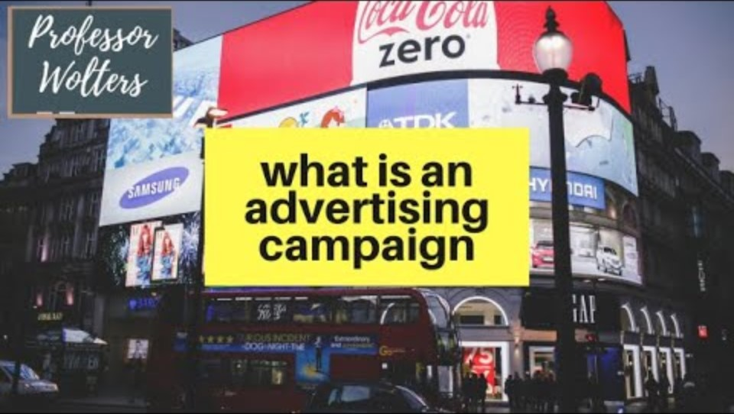
Advertising Campaign
An overview of advertising campaign

Slide 2

New Hired People
5 People were hired this month
They all are well qualified
They will have their training session soon

